Slide 1
NREL Geospatial Research Scientist Interview
Gabe Zuckerman
Notes:
Thanks...
Hi, welcome
thanks for being here. I'm really looking forwards to getting to know you all and hear more about your work, but first...

Slide 2
A little about myself …
Notes:
Grew up in Pittsburgh PA
Came to the Bay Area for college and have been here since, graduated with a BS in conservation and resource studies and a minor in CS
During college I worked as a cook at Chez Panisse, one of the restaurants that started the farm to table movement in the states
Into the outdoors, I love backpacking, I hiked the John Muir trail two summers ago.
Lately I’ve been really into rock climbing.

Slide 3

A little about myself …
Notes:
Grew up in Pittsburgh PA
Came to the Bay Area for college and have been here since, graduated with a BS in conservation and resource studies and a minor in CS
During college I worked as a cook at Chez Panisse, one of the restaurants that started the farm to table movement in the states
Into the outdoors, I love backpacking, I hiked the John Muir trail two summers ago.
Lately I’ve been really into rock climbing.

Slide 4
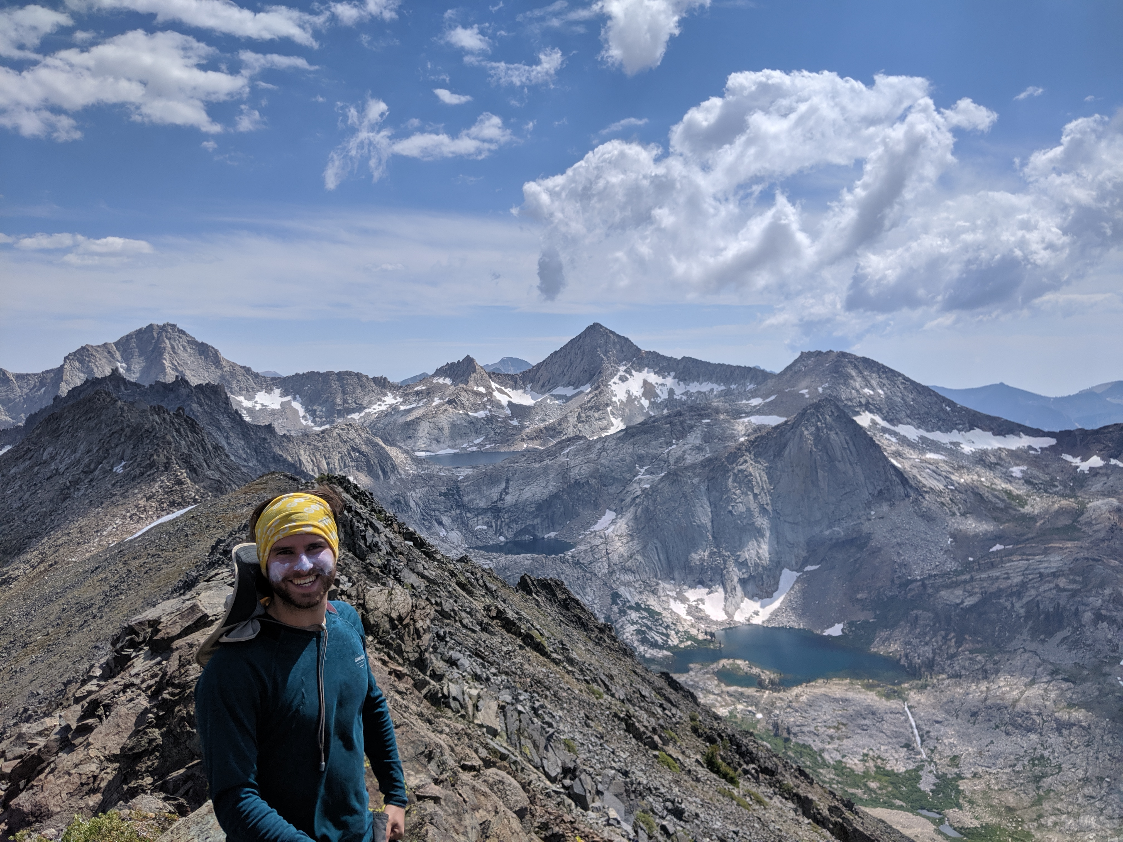
A little about myself …
Notes:
Grew up in Pittsburgh PA
Came to the Bay Area for college and have been here since, graduated with a BS in conservation and resource studies and a minor in CS
During college I worked as a cook at Chez Panisse, one of the restaurants that started the farm to table movement in the states
Into the outdoors, I love backpacking, I hiked the John Muir trail two summers ago.
Lately I’ve been really into rock climbing

Slide 5
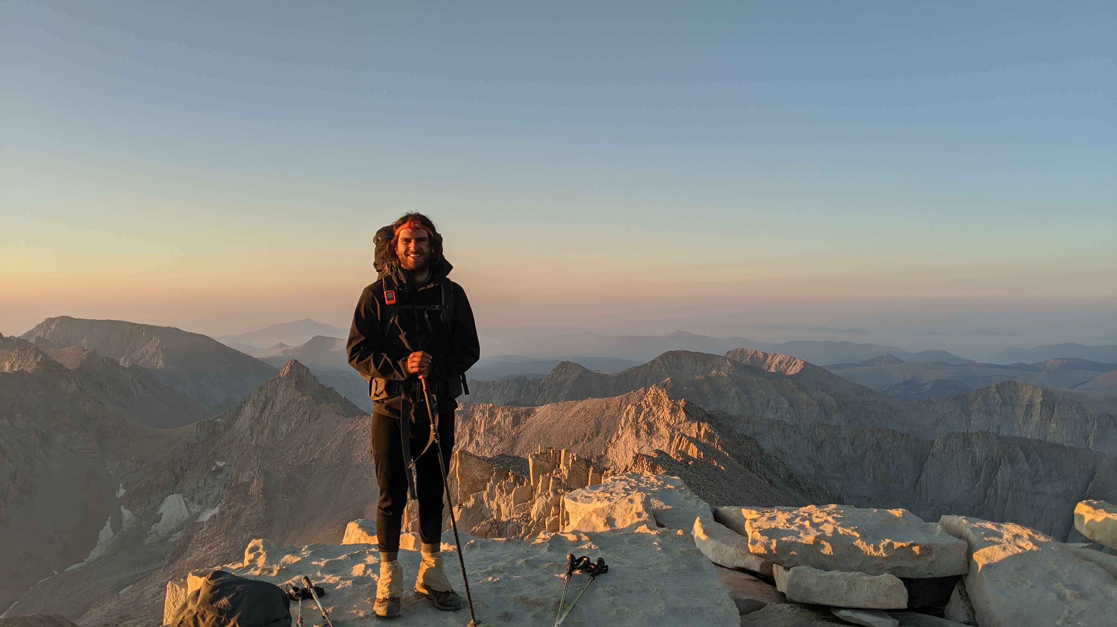
A little about myself …
Notes:
Grew up in Pittsburgh PA
Came to the Bay Area for college and have been here since, graduated with a BS in conservation and resource studies and a minor in CS
During college I worked as a cook at Chez Panisse, one of the restaurants that started the farm to table movement in the states
Into the outdoors, I love backpacking, I hiked the John Muir trail two summers ago. This is map I made for a photobook my buddies and I put together
Lately I’ve been really into rock climbing. I also have played soccer for as long as I can remember and love watching the premier league on the weekends

Slide 6
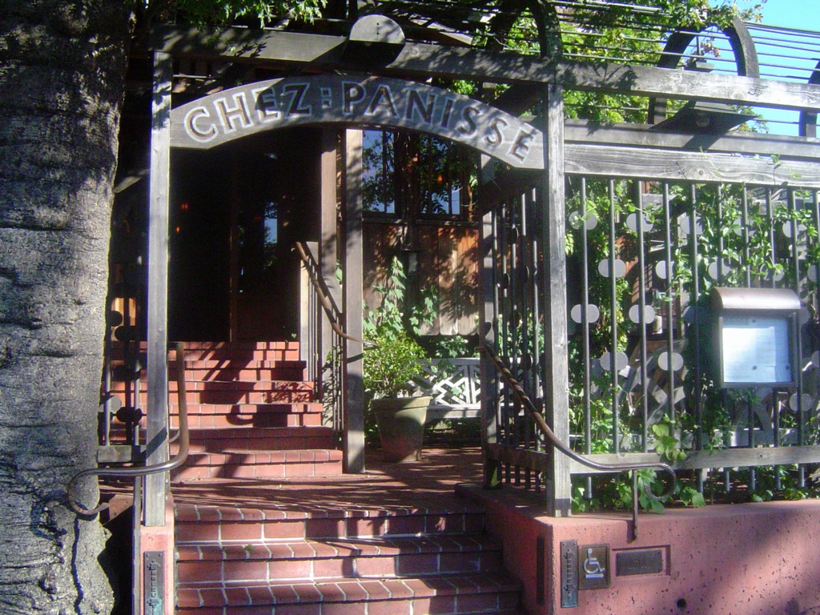
Professionally…
Notes:
Next, a bit about my professional backgournd
During my senior year, and the summer after I graduated I worked in Wayne Getz’s lab in the Environmental science policy and management depart at berekey.
Where I analyzed the use of memory in elephants in repeated trips

Slide 7
Professionally…
Chez Panisse
Notes:
Next, a bit about my professional backgournd
During my senior year, and the summer after I graduated I worked in Wayne Getz’s lab in the Environmental science policy and management depart at berekey.
Where I analyzed the use of memory in elephants in repeated trips

Slide 8

Professionally…
Chez Panisse
Getz lab
Notes:
Next, a bit about my professional backgournd
During my senior year, and the summer after I graduated I worked in Wayne Getz’s lab in the Environmental science policy and management depart at berekey.
Where I analyzed the use of memory in elephants in repeated trips

Slide 9
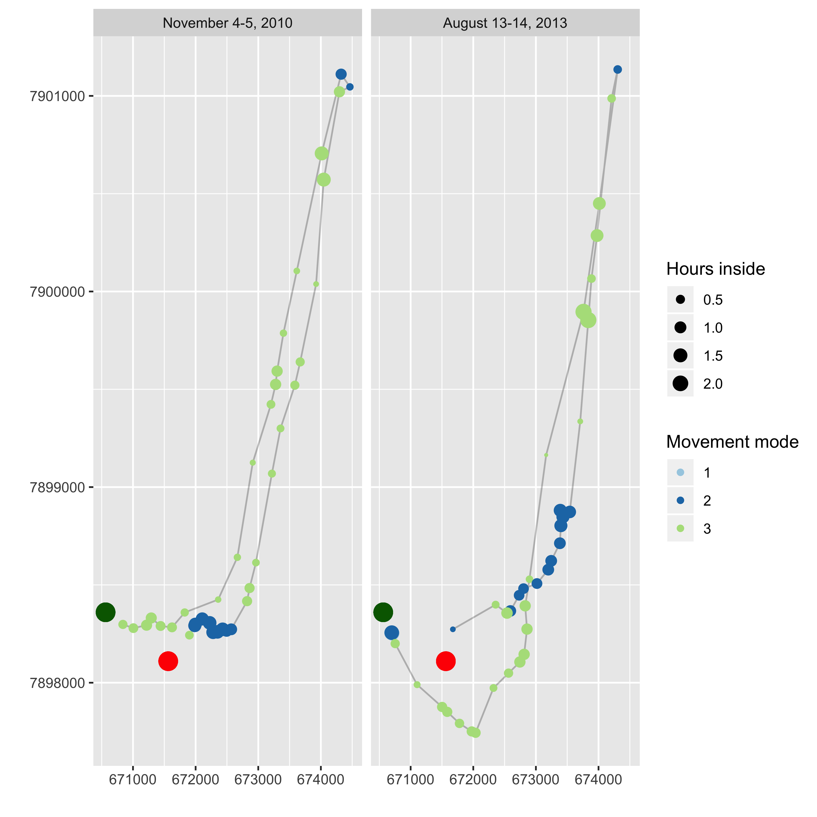
Professionally…
Chez Panisse
Getz lab
Notes:
During my senior year, and the summer after I graduated I worked in Wayne Getz’s lab. Where I analyzed the use of memory in elephants in repeated trips

Slide 10
Professionally…
Chez Panisse
Getz lab
Middleton lab
Notes:
After working in Wayne’s group, I transition to another group in ESPM—Arthur Middleton, where I am now.
I’ll get into more project specifics in a second, but a brief overview: the group specializes in wildlife ecology and conservation. In other words, most of us use animal movement gps points perform various analyses to inform conservation work and policy
I have been here since September of 2019—and I was brought in to build a database compiling a bunch of movement data from a range of collaborators. After getting that done, I transitioned to working on the projects I’ll describe in more detail later as well as others
Before I get into that, I will discuss the technical task I completed prior to the inteview

Slide 11
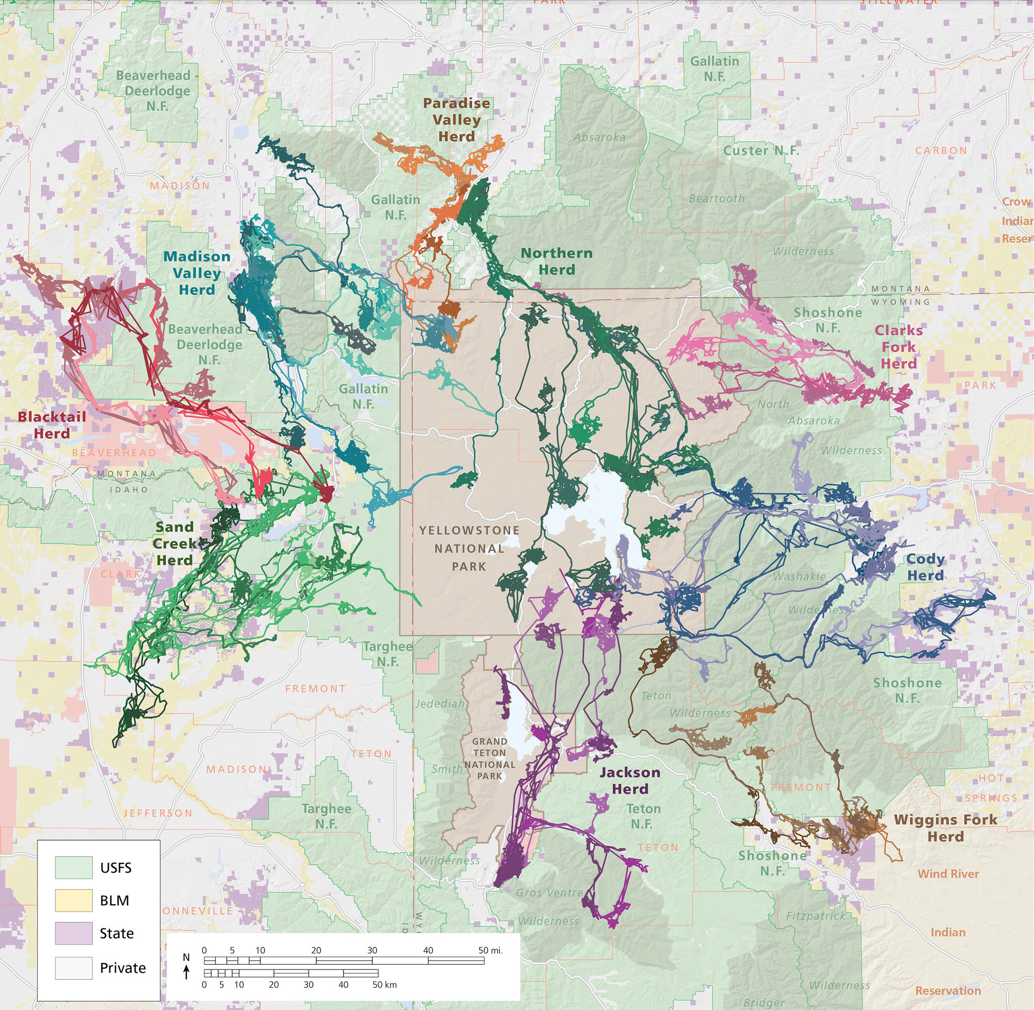
Professionally…
Chez Panisse
Getz lab
Middleton lab
From Rickbeil et al. 2019
Notes:
After working in Wayne’s group, I transition to another group in ESPM—Arthur Middleton, where I am now.
I’ll get into more project specifics in a second, but a brief overview: the group specializes in wildlife ecology and conservation. In other words, most of us use animal movement gps points perform various analyses to inform conservation work and policy
I have been here since September of 2019—and I was brought in to build a database compiling a bunch of movement data from a range of collaborators. After getting that done, I transitioned to working on the projects I’ll describe in more detail later as well as others
Before I get into that, I will discuss the technical task I completed prior to the inteview

Slide 12
Technical Task Overview

Slide 13
Technical Task Overview
Use WTK data to examine wind speed variability
Focus on diurnal and monthly temporal scales
Pilot the analysis on a single location, but write the code so that it could be scaled up

Slide 14
Technical Task Process
Familiarize myself with the data
Notes:
Played around with the hsds examples, did a little background research on get a better idea of the data structure (ie that it was a 2x2km gridded product etc)

Slide 15
Technical Task Process
Familiarize myself with the data
Lit review to understand variability metrics

Slide 16
Technical Task Process
Familiarize myself with the data
Lit review to understand variability metrics
Exploratory analysis
Notes:
Luckily, this was pretty quick thanks to a paper that came out of NREL Lee et al. 2018 (I’m sure you all know it), but as a refresher, it examined almost 30 variability metrics picking out Robust Coefficient of Variation as the best metric.

Slide 17
Technical Task Process
Familiarize myself with the data
Lit review to understand variability metrics
Exploratory analysis
Functionalize code

Slide 18
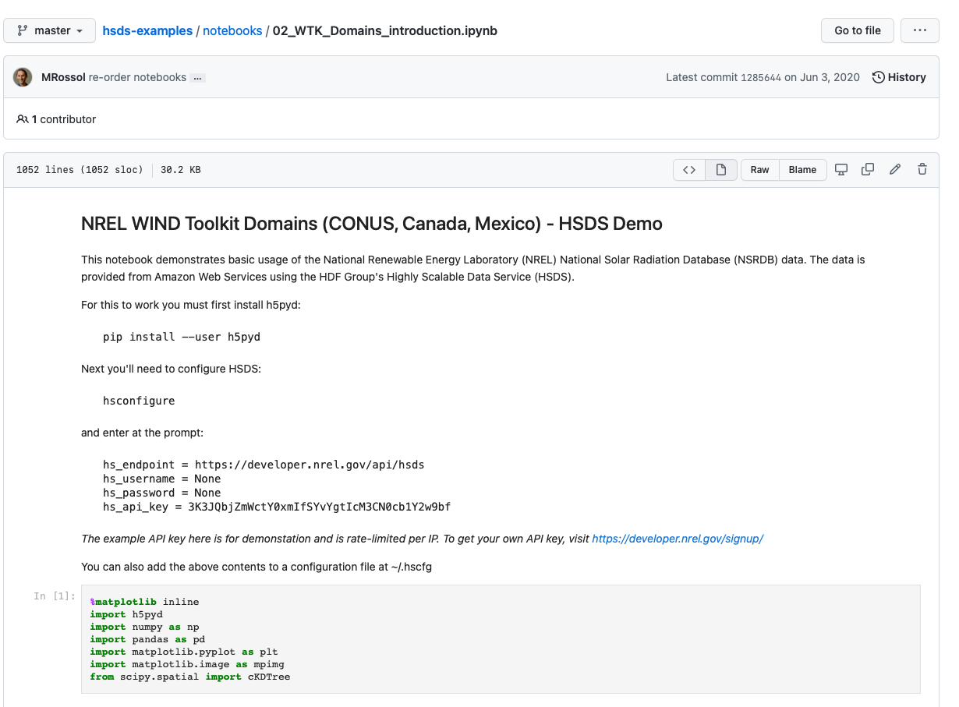
Technical Task Process
1. Familiarize myself with the data
Notes:
Downloaded the data in python using h5pyd package in jupyter notebooks, for this I used the windspeed at a 10m altitude
Played around with the hsds examples, did a little background research on get a better idea of the data structure (ie that it was a 2x2km gridded product etc)

Slide 19
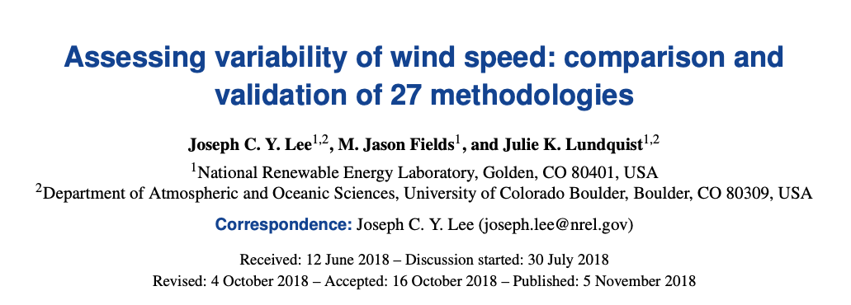
Technical Task Process
2. Lit review to understand variability metrics
Notes:
Luckily, this was pretty quick thanks to a paper that came out of NREL Lee et al. 2018 (I’m sure you all know it), but as a refresher, it examined almost 30 variability metrics picking out Robust Coefficient of Variation as the best metric.

Slide 20
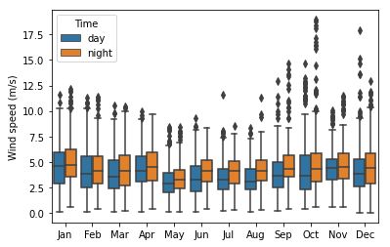
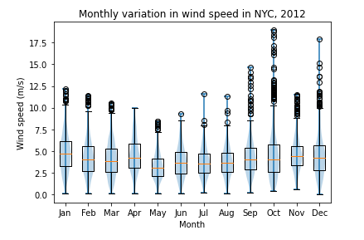
Technical Task Process
3. Exploratory analysis
Notes:
Created visualizations using matplotlib and seaborn libraries to create basic visualizations

Slide 21
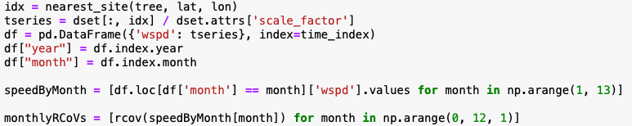
Technical Task Process
4. Functionalize code
Notes:
Don’t worry about the actual code here
What I mean by this is basically turinng the EDA into function such that it can be applied to any number of inputs, in parallel on HPC etc

Slide 22
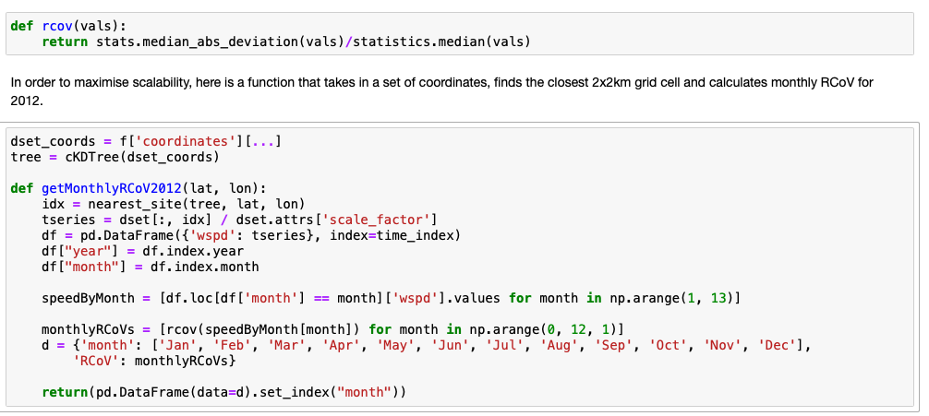
Technical Task Process
4. Functionalize code
Notes:
What I mean by this is basically turning the EDA into function such that it can be applied to any number of inputs, in parallel on HPC etc
So I followed EDA functionalize approach for both the monthly and hourly scales

Slide 23
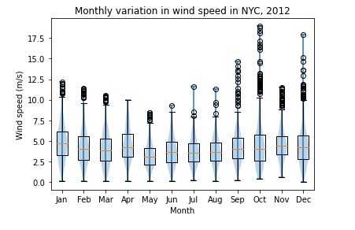
Technical Task Results
1. Monthly variation
Notes:
Here are some of the visualization I generated showing the variability of windspeeds in New York in the year 2012.
The fall and winter months visually seem to have the most variation (save for November), with long tails indicating many hours outlying windspeed

Slide 24
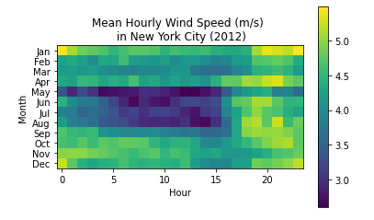
Technical Task Results
1. Monthly variation
Notes:
Here are some of the visualization I generated showing the variability of windspeeds in New York in the year 2012.
The fall and winter months visually seem to have the most variation (save for November), with long tails indicating many hours outlying windspeed

Slide 25
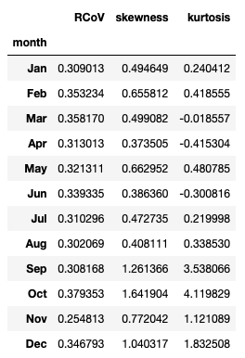
Technical Task Results
1. Monthly variation
Notes:
Visualizations are important and a great first step but in order to actually assess variability, we need some statistical measures.
Based off of the Lee et al. work from 2018. I went with the robust coefficient of variation (median absolute deviation / median). It’s important to note that this was found to be the best metric over an infinite timeline, they suggested that to use this metric to calculate Inter annual variation (over this infinite timespan) one would need about 10 years of data to get a good representation. However, this was using mean monthly datapoints, this has a higher temporal resolution of hourly records meaning we have more datapoints and more information to lead to a quicker true approximation
I also presented skewness and kurtosis as Lee et al. reported that they converged to their “true” values the quickest

Slide 26
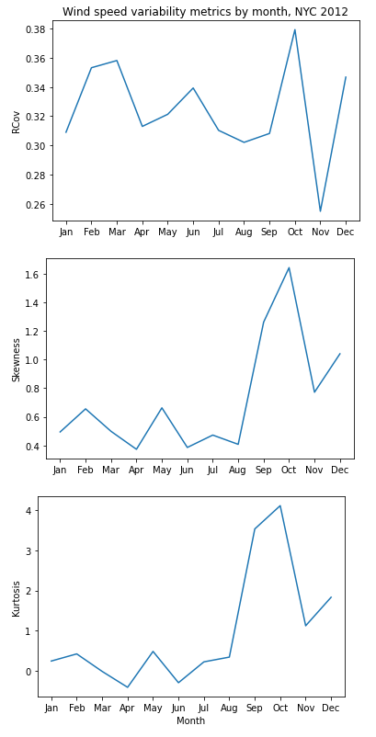
Technical Task Results
1. Monthly variation
Notes:
We can see here that the three metrics agree that the greatest variability occurred in October of 2012. And skewness and kurtosis produce similar results across the months as they are both metrics of tailedness
When it comes to the other months, the agreement is more relative. For example the RCoV metrics suggest November was the least variable, whereas the other two show that it was less variable than Oct. but still more variable than almost all the other months.

Slide 27
Technical Task Results
1. Monthly variation
Notes:
We can see here that the three metrics agree that the greatest variability occurred in October of 2012. And skewness and kurtosis produce similar results across the months as they are both metrics of tailedness
When it comes to the other months, the agreement is more relative. For example the RCoV metrics suggest November was the least variable, whereas the other two show that it was less variable than Oct. but still more variable than almost all the other months.
This is likely because of the relatively clumped distribution of the outlying windspeed records, which we can see if we go back to our oringal box plot

Slide 28
Technical Task Results
1. Monthly variation
Notes:
We can see here that the three metrics agree that the greatest variability occurred in October of 2012. And skewness and kurtosis produce similar results across the months as they are both metrics of tailedness
When it comes to the other months, the agreement is more relative. For example the RCoV metrics suggest November was the least variable, whereas the other two show that it was less variable than Oct. but still more variable than almost all the other months.
This is likely because of the relatively clumped distribution of the outlying windspeed records, which we can see if we go back to our oringal box plot

Slide 29
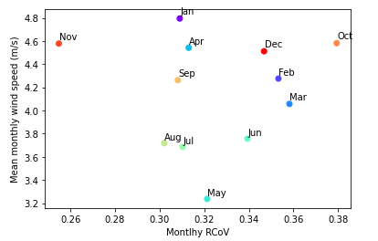
Technical Task Results
1. Monthly variation
Notes:
Why is a promt like this important. We’d ideally like to find a time where wind speeds are maximized and variability is minimized to ensure maximal energy production. Looking at this plot, we can see that in New York in 2012, we can see that November would be the best month for this

Slide 30
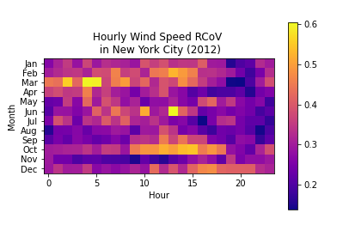
Technical Task Results
1. Monthly variation
Notes:
As an example of the scalability of the code, I calculated the RCoV for every hour in every month. Because of the functionalized approach, it only took one extra line of code to apply this to a dataframe of windspeeds grouped by month and hour instead of just month.

Slide 31
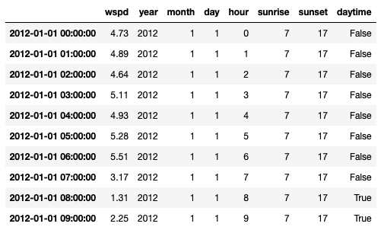
Technical Task Results
2. Diurnal variation
Notes:
Similarly it was only matter of changing a few lines in my code to find diurnal variation. One of the key changes was incorporating the pvlib package into my function to get the exact sunrise and sunset time for each day at a specific location. I could cut them to the hour because of the resolution of the data (although with this approach I added 1 to the sunset value to account for edge cases).

Slide 32
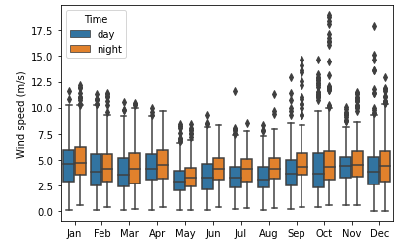
Technical Task Results
2. Diurnal variation
Notes:
With a daytime Boolean column it was simple to generate basic visualizations showing the variation between day and night windspeeds.

Slide 33
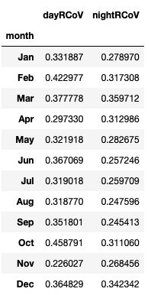
Technical Task Results
2. Diurnal variation
Notes:
And from here, it was simply a matter of choosing a location and inputting it into my function to generate RCoVs for day and night in New York City, 2012

Slide 34
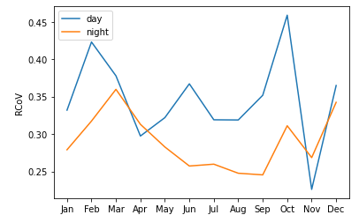
Technical Task Results
2. Diurnal variation
Notes:
And from here, it was simply a matter of choosing a location and inputting it into my function to generate RCoVs for day and night in New York City, 2012. The plot on the right shows the combined monthly and diurnal variation in windspeeds.

Slide 35
Technical Task Results
2. Diurnal variation
Notes:
The insight that we gain from this is clear by looking at the month of October. The variation in windspeeds during the day in October is what caused October to have the most variable windspeeds in 2012.

Slide 36
Technical Task Results
3. Scalability
Notes:
I have been hinting at it throughout my discussion of the technical task, but I wanted to explicity talk about how I designed my approach with scalability in mind.

Slide 37
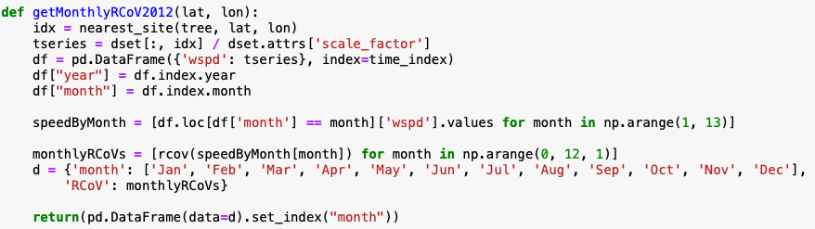
Technical Task Results
3. Scalability
Notes:
For example, getting a dataframe with monthly RCoV requires only a latitude and longitude. It efficiently finds the nearest grid cell and calculates the RCoV. The speed is really limited by the time to fetch the data from the API.

Slide 38
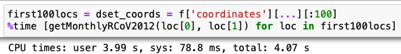
Technical Task Results
3. Scalability
Notes:
For example, getting a dataframe with monthly RCoV requires only a latitude and longitude. It efficiently finds the nearest grid cell and calculates the RCoV. The speed is really limited by the time to fetch the data from the API.
Running this code for 100 locations, on a single core on my first gen M1 mac book pro took about 4 seconds of CPU time. Because I used a free API key, it seems I was limited to a single API call at a time, and was thus unable to test the parallelized performance. However, I estimate running on an a single node of an HPC server (asumming 24 cores) this code could compute the montly RCoV in 2012 for roughly 2.5 million locations in a little more than an hour + a little wait time at the start/end.

Slide 39
Technical Task Questions?
Notes:
I thought it be best to have a couple minutes for questions about the technical task here, rather than at the end.
Next I’ll be discussing two projects geospatial modelling proejcts.

Slide 40
Diverse migratory portfolios and anthropogenic development drive inter-annual migratory plasticity in GYE Elk Geospatial modeling project #1
Brief overview
Notes:
That highlights the importance of the work

Slide 41
Diverse migratory portfolios and anthropogenic development drive inter-annual migratory plasticity in GYE Elk Geospatial modeling project #1
Brief overview
Methodology
Notes:
This is where I’ll spend the bulk of the time, making sure to discuss the use of the large datasets, open source tools, and advanced spatial models

Slide 42
Diverse migratory portfolios and anthropogenic development drive inter-annual migratory plasticity in GYE Elk Geospatial modeling project #1
Brief overview
Methodology
Results
Notes:
Finally I’ll wrap up with a discussion of the results and their significance.
I will be showing the key visualization along the way some of the key visualizations. This project is undergoing some final prepartions before being shared with co-authors (of which there are a lot bc of the large data set it uses) before submission as a first author manuscript to the journal Ecosphere

Slide 43
Diverse migratory portfolios and anthropogenic development drive inter-annual migratory plasticity in GYE Elk Geospatial modeling project #1
Brief overview
Methodology
Results
Questions
Notes:
Then I’ll have a brief space for questions about this particular project before jumping into the next project

Slide 44
Diverse migratory portfolios and anthropogenic development drive inter-annual migratory plasticity in GYE Elk Geospatial modeling project #1
1. Brief overview
Many ungulates exhibit partial migration
Notes:
So we’re all aware that ungulates, or even toed mammals, migrate 100s of km all around the world but also here in North America in and around the rocky mountains

Slide 45
Diverse migratory portfolios and anthropogenic development drive inter-annual migratory plasticity in GYE Elk Geospatial modeling project #1
1. Brief overview
Many ungulates exhibit partial migration
Until recently, there only existed migrants and residents with fixed behaviors
Notes:
But with the onset of GPS tracking, more strategies emerged eg short distance migrants, long dist elev…
And we began to realize that these ungulates actually shift strategies from year to year

Slide 46
Diverse migratory portfolios and anthropogenic development drive inter-annual migratory plasticity in GYE Elk Geospatial modeling project #1
1. Brief overview
Many ungulates exhibit partial migration
Until recently, there only existed migrants and residents with fixed behaviors
No evidence of switching between strategies for elk in the GYE
From Rickbeil et al. 2019
Notes:
Elk are an especially important species, sustaining recovering large carnivores including the gray wolf (Canis lupus), Grizzly bear (Ursus arctos horribilis), and mountain lion (Puma concolor) as well as substantial human harvest
They also link farflung ecosystems together because of long migrations ie winter in Cody can affect the number of elk that tourist can see in GTNP near Jackson in the summer

Slide 47
Diverse migratory portfolios and anthropogenic development drive inter-annual migratory plasticity in GYE Elk Geospatial modeling project #1
1. Brief overview
Many ungulates exhibit partial migration
Until recently, there only existed migrants and residents with fixed behaviors
No evidence of switching between strategies for elk in the GYE
Do elk switch between movement strategies? And if so, why?
From Rickbeil et al. 2019
Notes:
This is an important question in the face of declining migrations both worldwide and in the GYE
declining migration and increasing residency are causing serious management challenges due to larger aggregations of elk on agricultural lands, increasing crop damage and heightening the risk of disease transmission to livestock

Slide 48
Diverse migratory portfolios and anthropogenic development drive inter-annual migratory plasticity in GYE Elk Geospatial modeling project #1
2. Methodology
Notes:
Three key components to the analysis, the first is the movement data

Slide 49
Diverse migratory portfolios and anthropogenic development drive inter-annual migratory plasticity in GYE Elk Geospatial modeling project #1
2. Methodology
Movement data
Notes:
You might remember I was originally brough on to create a database. So this project relied up data within the database—a little about the database. I build it using PostgreSQL – and it contains some 2000 elk and 16 mil movement datapoints.
After cleaning the data, eg remove erroneous points (due to gps errors), we extracted all the data for individuals for which there was more than 2 consecutive years (bc we wanted to look at switching data) using R. The rest of this project was completed in R unless I say otherwise
Just a quick mention that I understand this group is a python group. This shouldn’ t really pose a problem for me as I’ve been using python since I learned to code some six years ago now. It just seems that the fields of wildlife ecology and conservation rely up on R
This left us with a dataset of some 350 elk fom 2005-2020 and about 5 million gps points—so a sizeable datase

Slide 50

Diverse migratory portfolios and anthropogenic development drive inter-annual migratory plasticity in GYE Elk Geospatial modeling project #1
2. Methodology
Movement data
Classification of movement strategies
Notes:
For each of those years, we identified the start and end dates of migration (if they migrated) using an interactive R shiny app I built

Slide 51
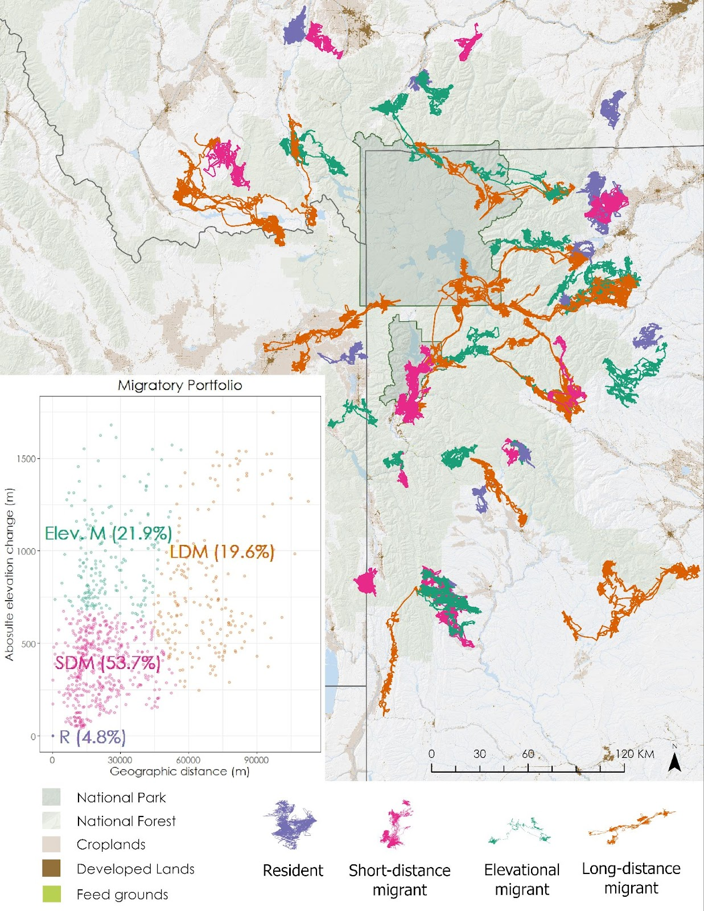
Diverse migratory portfolios and anthropogenic development drive inter-annual migratory plasticity in GYE Elk Geospatial modeling project #1
2. Methodology
Movement data
Classification of movement strategies
Notes:
Using the start and end dates, I extracted elevational and geographic distances between summer and winter ranges and used k-means to classify them, assigning labels based upon where they fell on this two dimensional spectrum of migration

Slide 52
Diverse migratory portfolios and anthropogenic development drive inter-annual migratory plasticity in GYE Elk Geospatial modeling project #1
2. Methodology
Movement data
Classification of movement strategies
ID switching events
Notes:
Simiple script to see if elk-year 1 has the same strategy as elk year 2

Slide 53
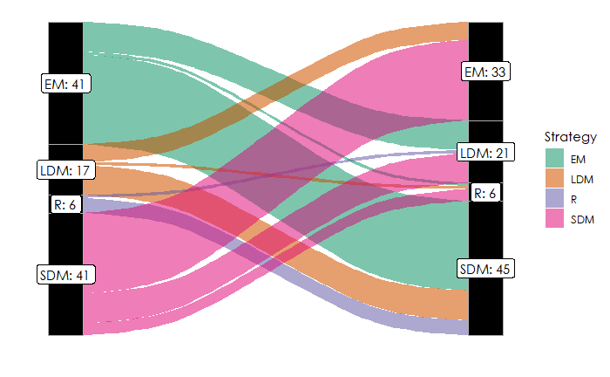
Diverse migratory portfolios and anthropogenic development drive inter-annual migratory plasticity in GYE Elk Geospatial modeling project #1
2. Methodology
Movement data
Classification of movement strategies
ID switching events
Notes:
This figure shows the flow rates between strategies. We can see there there are the fewest switches from a resident strategy and the most from Short distance migrants

Slide 54
Diverse migratory portfolios and anthropogenic development drive inter-annual migratory plasticity in GYE Elk Geospatial modeling project #1
2. Methodology
Movement data
Causes of switching behavior
Notes:
Now that we have identified the switching behavior the next step is to figure out what is causing it
We used a hypothesis testing approach and then used an AIC based modeling approach to determine most likely cause, but before we get there we have to have covariate and this where many of the spatial analyses and HPC come into play

Slide 55
Diverse migratory portfolios and anthropogenic development drive inter-annual migratory plasticity in GYE Elk Geospatial modeling project #1
2. Methodology
Movement data
Causes of switching behavior
Environmental covariates
Notes:
Now that we have identified the switching behavior the next step is to figure out what is causing it
We used a hypothesis testing approach and then used an AIC based modeling approach to determine most likely cause, but before we get there we have to have covariate and this where many of the spatial analyses and HPC come into play

Slide 56

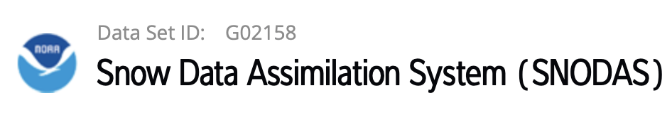
Diverse migratory portfolios and anthropogenic development drive inter-annual migratory plasticity in GYE Elk Geospatial modeling project #1
2. Methodology
Movement data
Causes of switching behavior
Environmental covariates
Snow depth
Notes:
Using google earth engine, I associated every location in an elks winter range with a snowdepth form the SNODAS dataset from NOAA (this was the one piece of the analysis conducted in python bc of the GEE API).
This is a lot of cpmputation and unfortunately GEE doesn’t allow calls in parallel, so I had to created a batched approach that notified the number of days (in each batch) that had a missing records.

Slide 57
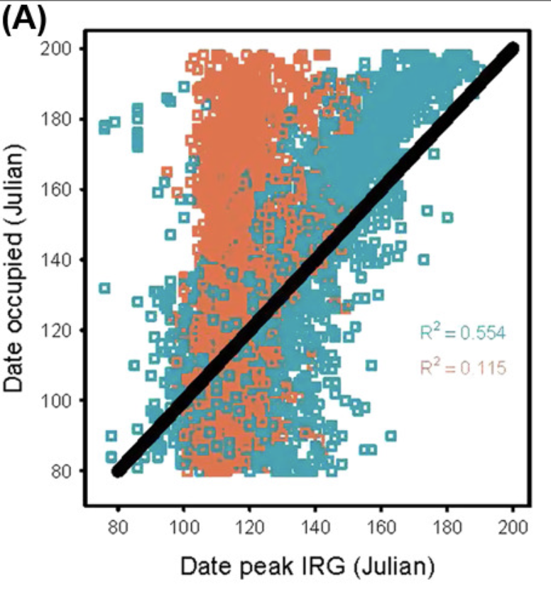
Diverse migratory portfolios and anthropogenic development drive inter-annual migratory plasticity in GYE Elk Geospatial modeling project #1
2. Methodology
Movement data
Causes of switching behavior
Environmental covariates
Snow depth
Green wave surfing
From Middleton et al. 2018
Notes:
Green wave surfing refers to animals tracking emerging vegation in order to obtain maximal forage benefits during migration. It is calculated by taking the first derivative of a yearlong NDVI timeseries, a value refered to as Instantaneous rate of green up. The day that has the maximal IRG to as the date of peak green up. And a sufing score/ability is calculated by the mismatch between the date an elk occupied a location and the data at which it had peak greenup. So a lower score is better.
The figure on the right shows the differences in gws for migrants in blue and resident elk in orange.
Thanksfully I only had to calculate calculate this for dates during the migratory period, so for only about 1-2 million locations. However these locations spanned an area greater than 150k sq km. so I had to come up with an efficient approach to creating these yearlong timeseries needed to generate IRG curves from 250 m MODIS terra imagery. After downloading modis imagergy and applied bit filters to ensure pixel quality
Thanks to some great R packages including sf, tidyverse and especially velox I was able to extract ndvi timeseries for every point. Then using the irg r package, I was able to fit irg curves and extract days from peak green up for every point in parallel on Berkeleys HPC system in a reasonable amount of time

Slide 58
Diverse migratory portfolios and anthropogenic development drive inter-annual migratory plasticity in GYE Elk Geospatial modeling project #1
2. Methodology
Movement data
Causes of switching behavior
Environmental covariates
Anthropogenic covariates
Notes:
Interestingly, in the us populations near protected areas have increased by more than three times since 1940, so this obviously lead to some unintended (as well as intentional) consequences on the wildlife.
The extraction of these covariates differs from the environmental one in the fact that they were not extracted at the point level but rather at the seasonal range level. We calculated the spatial extents of season ranges using a 99% isopleth of a Brownian bridge movement model—a conservative estimate of a utilization distribution with a 100m resolution. To compute the 1000’s of seasonal ranges, I again utilized Berkeleys HPC
We then

Slide 59
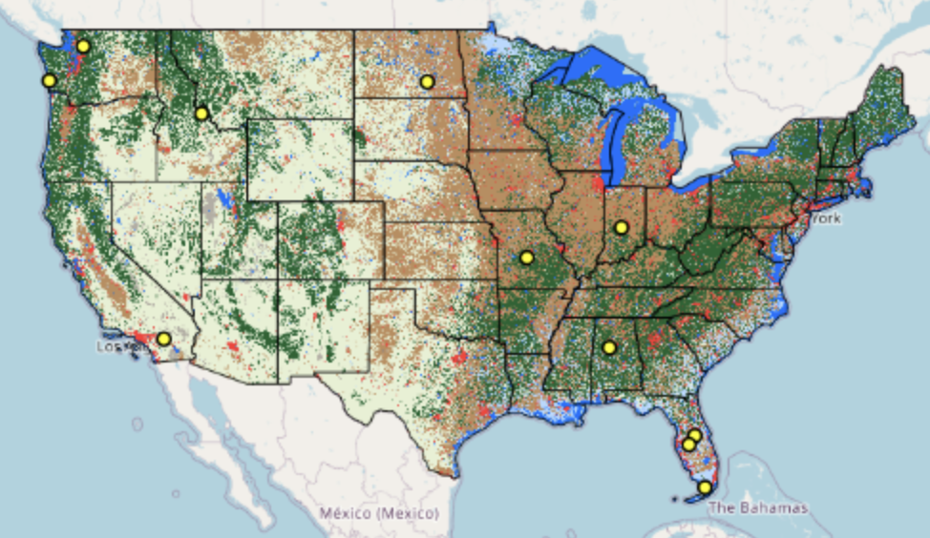

Diverse migratory portfolios and anthropogenic development drive inter-annual migratory plasticity in GYE Elk Geospatial modeling project #1
2. Methodology
Movement data
Causes of switching behavior
Environmental covariates
Anthropogenic covariates
Developed lands
Crop lands
Land Change Monitoring, Assessment, and Projection
Notes:
We then extracted the proportion of developed and crop lands from the open source LCMAP dataset (30 meter resolution, yearly land cover product) in winter (dev and crop) and migratory ranges (dev only). SF and velox r packages

Slide 60
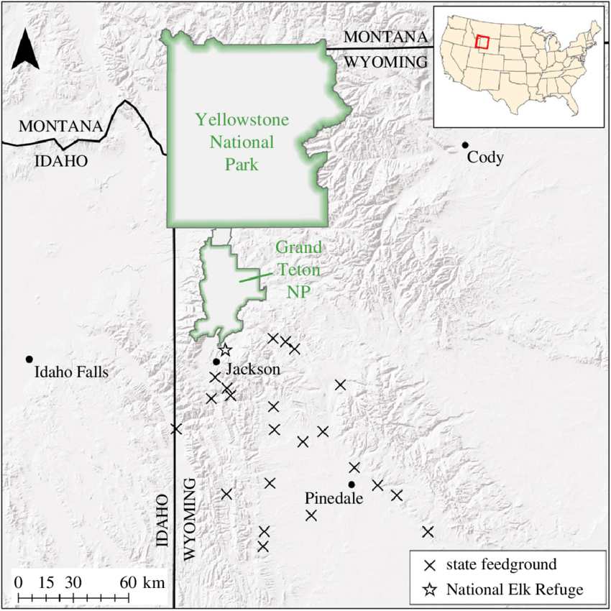
Diverse migratory portfolios and anthropogenic development drive inter-annual migratory plasticity in GYE Elk Geospatial modeling project #1
2. Methodology
Movement data
Causes of switching behavior
Environmental covariates
Anthropogenic covariates
Developed lands
Crop lands
Feed grounds
From Cole et al. 2018
Notes:
The one intentional impact on elk is that they are fed in the state of Wyoming during the winter. So using those same winter ranges as well as feedground locations, I extracted and labeled the ranges that contained at least one feed ground using the sf r package

Slide 61
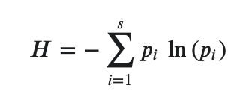
Diverse migratory portfolios and anthropogenic development drive inter-annual migratory plasticity in GYE Elk Geospatial modeling project #1
2. Methodology
Movement data
Causes of switching behavior
Environmental covariates
Anthropogenic covariates
Socio-cultural knowledge transmission
Adopted from Lowrey et al. 2020
Notes:
I wont get too much into this one, but basically there has been growing evidence of transimission of landscape knowledge that increases/restores migratoryness.
So I calculated herd-level movement strategy diversity by adopting Shannon’s H-diversity index with the proportions of the 4 migratory strategies in each of the herds.

Slide 62
Diverse migratory portfolios and anthropogenic development drive inter-annual migratory plasticity in GYE Elk Geospatial modeling project #1
2. Methodology
Movement data
Causes of switching behavior
Modeling
Notes:
As I mentioned earlier, we used a hypothesis testing and an AIC based modeling approach to determine most likely causes of switching from each of the 4 strategies. More specifically we fit logistic regression with for each hypothesis by itself as well as each of the two-way interactions

Slide 63
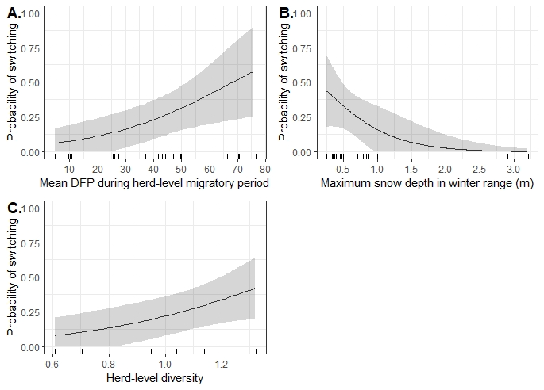
Diverse migratory portfolios and anthropogenic development drive inter-annual migratory plasticity in GYE Elk Geospatial modeling project #1
3. Results
Movement data
Causes of switching behavior
Modeling
Switching from a resident strategy
Notes:
The top models suggested that resident elk were most likely to switch strategies with poor green-wave surfing, low snowdepths (due to decrease energy expenditure required to migrate) and higher levels of movement strategy diversity

Slide 64
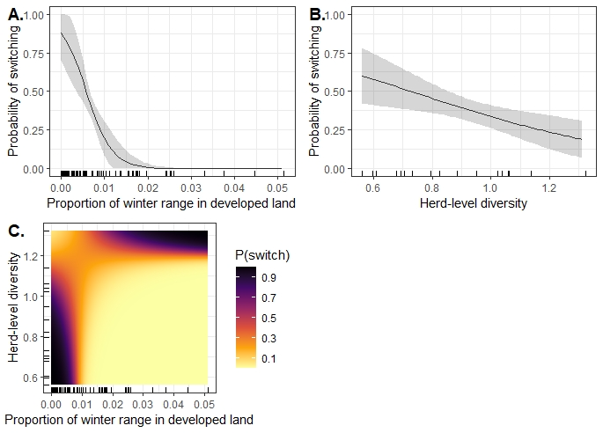
Diverse migratory portfolios and anthropogenic development drive inter-annual migratory plasticity in GYE Elk Geospatial modeling project #1
3. Results
Movement data
Causes of switching behavior
Modeling
Switching from an elevational migrant strategy
Notes:
This one was interesting. The top models suggested that elevational migrants were most likely to switch strategies in lowlevels of movement diversity and winter developed land, but looking at the interaction term (C) we can see that switching is very likely to happen elk ecperience high levels of developed land and high herd diversity at the same time.

Slide 65
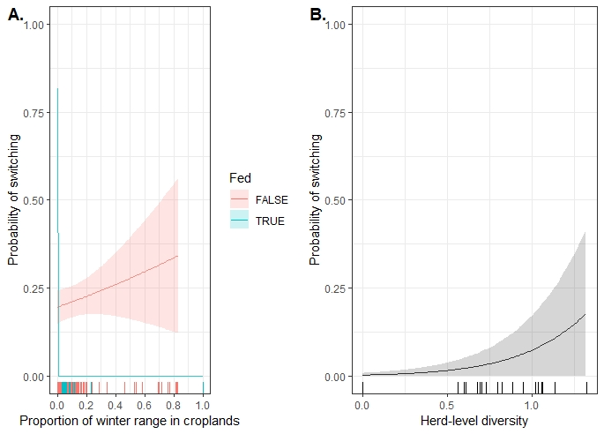
Diverse migratory portfolios and anthropogenic development drive inter-annual migratory plasticity in GYE Elk Geospatial modeling project #1
3. Results
Movement data
Causes of switching behavior
Modeling
Switching from a short distance migrant strategy
Notes:
This one was also interesting. The top models suggested that fed short distance migrants were most likely to switch strategies if they did not have access to crop lands and if they weren’t fed sdm were more likely to switch if they had more access to crops in the winter range
SDMs were also more likely to switch as herd-level movement strategy diversity increase

Slide 66
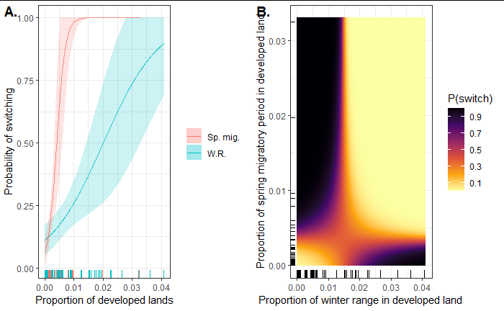
Diverse migratory portfolios and anthropogenic development drive inter-annual migratory plasticity in GYE Elk Geospatial modeling project #1
3. Results
Movement data
Causes of switching behavior
Modeling
Switching from a long distance migrant strategy
Notes:
This is the most important finding, as people care the most about the charismatic long distance migrants. This basically shows that even at very low levels of developed lands in winter range and along migratory corridors long distance migrants are very likely to switch movement tactics. This finding is backed up by similar finding in other ungulates changing behavior even sat very low levels of development

Slide 67
Diverse migratory portfolios and anthropogenic development drive inter-annual migratory plasticity in GYE Elk Geospatial modeling project #1
4. Questions??
Movement data
Causes of switching behavior
Modeling
Notes:
I know that was a whirlwind of information, but I’ll take a second now to see if any of you have questions about this section of the presentaion

Slide 68
Wildlife migrations highlight importance of working lands in the Greater Yellowstone Ecosystem Geospatial modeling project #2

Slide 69
Wildlife migrations highlight importance of working lands in the Greater Yellowstone Ecosystem Geospatial modeling project #2
Brief overview
Methodology
Results
Questions
Notes:
I’ll follow the same general organization in my discussion of this project
I co-led the analysis on this project and am the third author on the manuscript that is currently with the multitude of co-authors. We are hoping to publish in biological conservation

Slide 70
Wildlife migrations highlight importance of working lands in the Greater Yellowstone Ecosystem Geospatial modeling project #2
1. Brief overview
Protected areas (PAs) have long been heralded as best approach to conserve wildlife
Notes:
I’ll follow the same general organization in my discussion of this project

Slide 71
Wildlife migrations highlight importance of working lands in the Greater Yellowstone Ecosystem Geospatial modeling project #2
1. Brief overview
Protected areas (PAs) have long been heralded as best approach to conserve wildlife
But PAs have some short comings
Notes:
including often being too small to meet the needs of wide-ranging species, (Maiorano et al. 2008), having limited connectivity with other protected areas (Saura et al. 2018), and having high levels of human development immediately beyond protected area boundaries
As well as having been created by displacing the native poepls
This is all made especially clear when looking at elk in the GYE

Slide 72
Wildlife migrations highlight importance of working lands in the Greater Yellowstone Ecosystem Geospatial modeling project #2
1. Brief overview
Protected areas (PAs) have long been heralded as best approach to conserve wildlife
But PAs have some short comings
There is a need to highlight the importance of adjacent working and private lands in the role of wildlife conservation
Notes:
And given that the GYE is right in the middle of an area full of natural resources agriculture and a growing human population, it is the perfect study system. So we evaluated the anthropogenic land uses that elk face in their seasonal ranges
This is especially relevant given the recent movement behind the 30x30 conservation work

Slide 73
Wildlife migrations highlight importance of working lands in the Greater Yellowstone Ecosystem Geospatial modeling project #2
2. Methods
Notes:
And given that the GYE is right in the middle of an area full of natural resources agriculture and a growing human population, it is the perfect study system

Slide 74
Wildlife migrations highlight importance of working lands in the Greater Yellowstone Ecosystem Geospatial modeling project #2
2. Methods
Movement data
Notes:
Again all of this data comes from the database, however we did not limit it to elk with multiple years of data, so this analysis included over 1000 elk from 26 different herds across the GYE
And again we classified the movement strategies using that interactive app I built in R shiny
And once again we built seasonal ranges using the Brownian bridge movement models. This time, it was even more computationally expensive bc we had 1000+ elk with up to 24 gps fixes a day that had. Bc of the size (8m gps) I again utilized Berkeley’s HPC

Slide 75
Wildlife migrations highlight importance of working lands in the Greater Yellowstone Ecosystem Geospatial modeling project #2
2. Methods
Movement data
Human land uses
Notes:
After the elk spatial data was ready, the next step was to bring together spatial data for all the relevant human land uses in the system

Slide 76

Wildlife migrations highlight importance of working lands in the Greater Yellowstone Ecosystem Geospatial modeling project #2
2. Methods
Movement data
Human land uses
Land ownership
Notes:
We used open source land ownership data from the BLM

Slide 77
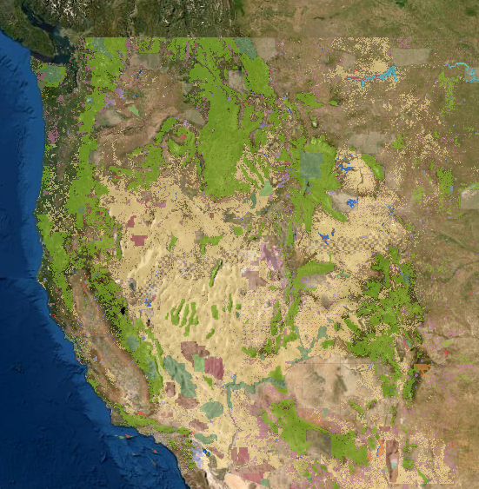


Wildlife migrations highlight importance of working lands in the Greater Yellowstone Ecosystem Geospatial modeling project #2
2. Methods
Movement data
Human land uses
Land ownership
Protected Areas
Notes:
We used open source protected area data from the GAP PADUS data from USGS and easement data from Natl conservation easement database

Slide 78
Wildlife migrations highlight importance of working lands in the Greater Yellowstone Ecosystem Geospatial modeling project #2
2. Methods
Movement data
Human land uses
Land ownership
Protected Areas
Private land owners
Notes:
Thought not open source, we included data from land grid and report all to identify owners of private land parcels in the 20 or so counties surrounding the GYE

Slide 79

Wildlife migrations highlight importance of working lands in the Greater Yellowstone Ecosystem Geospatial modeling project #2
2. Methods
Movement data
Human land uses
Land ownership
Protected Areas
Private land owners
Fence density
Notes:
We estimated fence density using USFS grazing allotment boundaries as well as private parcels. We validated our approach with visual inspection of high resolution imagery and scaled estimates by our type 1 error rates.

Slide 80

Wildlife migrations highlight importance of working lands in the Greater Yellowstone Ecosystem Geospatial modeling project #2
2. Methods
Movement data
Human land uses
Land ownership
Protected Areas
Private land owners
Fence density
Road density
Notes:
We calculated road density using US census tiger lines data

Slide 81



Wildlife migrations highlight importance of working lands in the Greater Yellowstone Ecosystem Geospatial modeling project #2
2. Methods
Movement data
Human land uses
Land ownership
Protected Areas
Private land owners
Fence density
Road density
Wind turbine + oil and gas infrastructure density
Notes:
WY Oil and Gas Conservation Commission (http://pipeline.wyo.gov/legacywogcce.cfm), the MT Board of Oil and Gas (http://www.bogc.dnrc.mt.gov/gisdata/WellSurface/), United States Wind Turbine Database (Hoen et al., 2018)

Slide 82

Wildlife migrations highlight importance of working lands in the Greater Yellowstone Ecosystem Geospatial modeling project #2
2. Methods
Movement data
Human land uses
Land ownership
Protected Areas
Private land owners
Fence density
Road density
Wind turbine + oil and gas infrastructure density
Current and future building densities
Notes:
Current building densities via the Microsoft US Building Footprints shapefile
Future building densities via contacting the 20 or so county offices for zoning data and digitizing pdf version. I should take a second here to mention that we mentored undergraduates throughout this initial data gathering phase that helped us with the digitization and fence density validation

Slide 83


Wildlife migrations highlight importance of working lands in the Greater Yellowstone Ecosystem Geospatial modeling project #2
2. Methods
Movement data
Human land uses
Land ownership
Protected Areas
Private land owners
Fence density
Road density
Wind turbine + oil and gas infrastructure density
Current and future building densities
Agriculture
Notes:
Ag from USDA cropscape

Slide 84
Wildlife migrations highlight importance of working lands in the Greater Yellowstone Ecosystem Geospatial modeling project #2
2. Methods
Movement data
Human land uses
Land ownership
Protected Areas
Private land owners
Fence density
Road density
Wind turbine + oil and gas infrastructure density
Current and future building densities
Agriculture
Livestock grazing intensity
Notes:
Bureau of Land Management Rangeland Administration System (https://reports.blm.gov/reports/RAS) and individual US Forest Service Forest offices

Slide 85
Wildlife migrations highlight importance of working lands in the Greater Yellowstone Ecosystem Geospatial modeling project #2
2. Methods
Movement data
Human land uses
Wrangling it all together
Notes:
After acquiring all the spatial data we had a massive data wrangling effort in which we had transform all the imagery to the same extent, raster or vectorize it, depending on the type of calculation we were performing and only then could we actually layer the seasonal ranges on top and extract all the values we wanted
A lot of this work was done using ArcGIS, but could just have easily been accomplished in QGIS. What wrangling we did not use Arc for we conducted in R, and all the calculation were done in R.

Slide 86
Wildlife migrations highlight importance of working lands in the Greater Yellowstone Ecosystem Geospatial modeling project #2
3. Results
Notes:
There are many results, but I’ll stick the those shown in our two main visualization

Slide 87
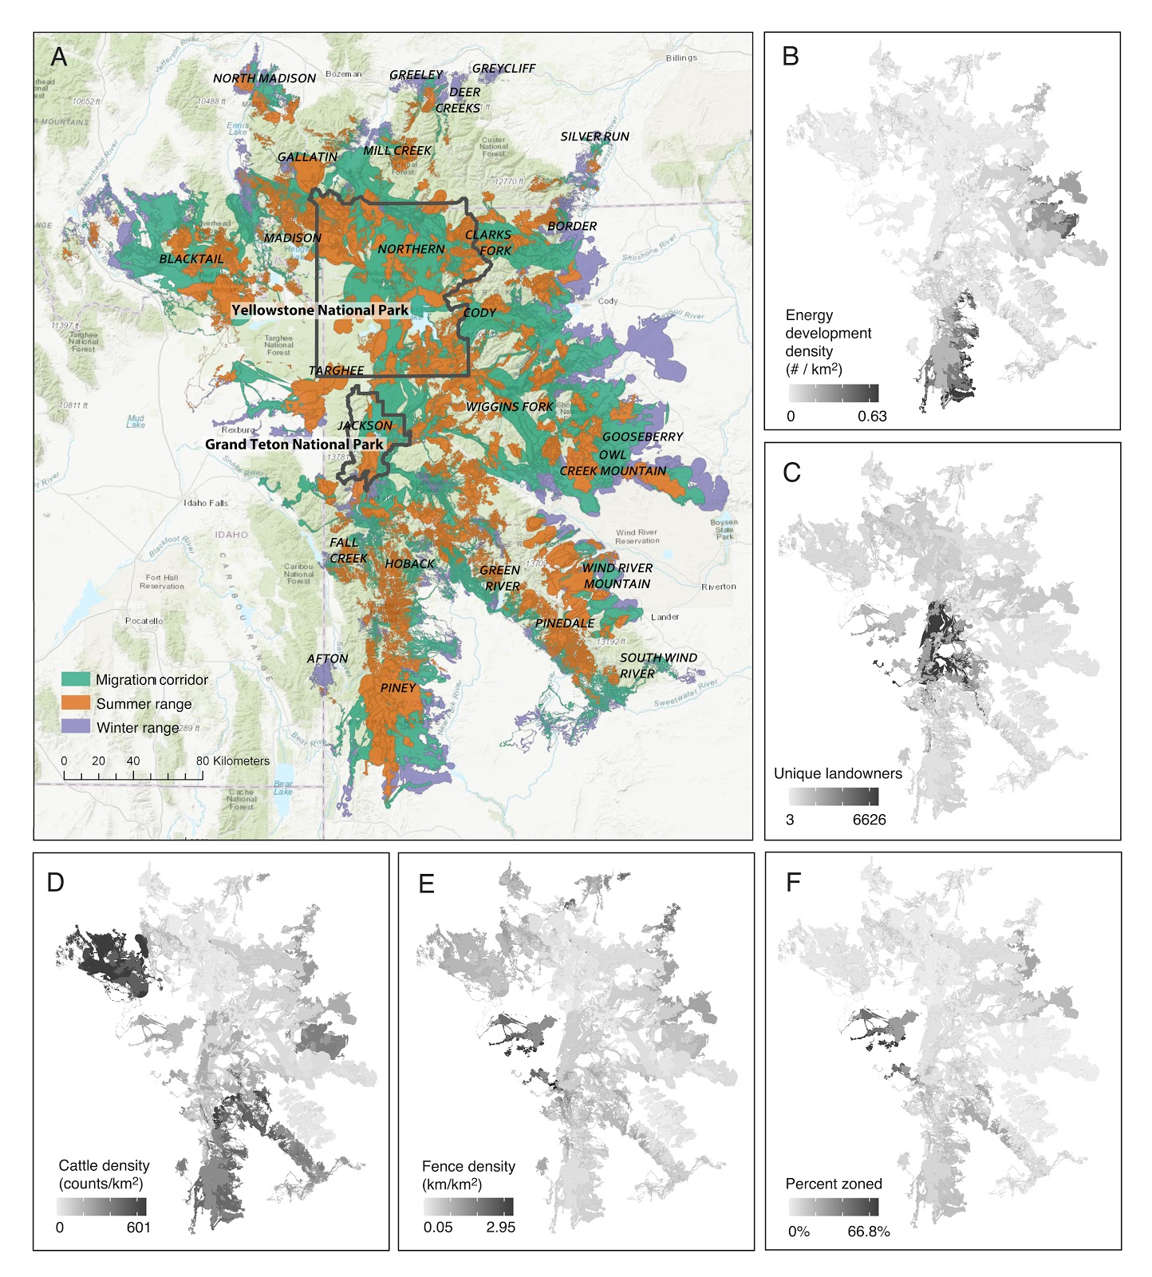
Notes:
This figure show the exent of our data across the GYE and highlights some of the anthropogent threats. the variety threats faced in different regions unforuntaely means there is not going to be one solution that can solve all the problems, we need more localized plans that harmonize with the state and national plans if we want to protect this charismatic elk migrations
Just focusing on a couple of the panels here, looking at c we can see the area in the middle there has a really high number of land owners which could make projects like conservation easements more diffucilt
Looking at panel f, we see the most of the ranges fall into counties that are not zoned, which means there is no limit to building, which we know negatively imapct the movement of migratory ungulates

Slide 88
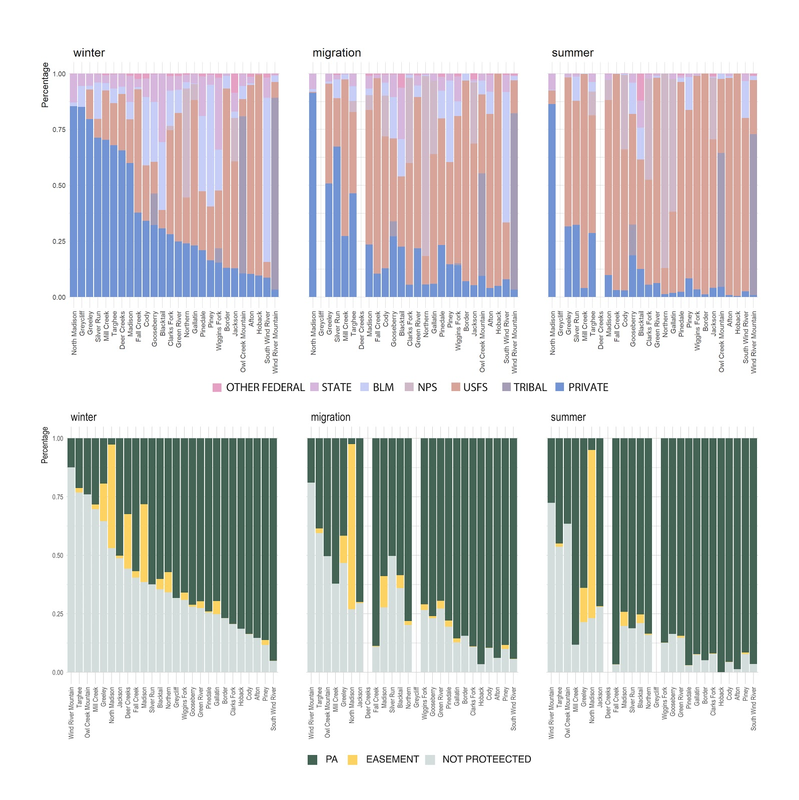
Notes:
This figure really highlights just how much cooperation is needed—elk spend there time in a multiude of management regimes, and depending on the season much of the time they are in unprotected lands. Goes back to the point that PAs alone are not the solutions

Slide 89
Wildlife migrations highlight importance of working lands in the Greater Yellowstone Ecosystem Geospatial modeling project #2
4. Questions??
Notes:
That was more straight forward then the first project I showcased as it was a layering project, but it still depended on a whole bunch of open source data and computation tools
Anyways, happy to take any questions now!

